Slide 1
GPU/CUDA workshop
SMP
2018/10/26

Slide 2
GPU
Applications
Parallel Computing & Numerical Methods
CUDA & Parallel Computing Related
OS & Driver lever
CPU Architecture
GPU Architecture

Slide 3
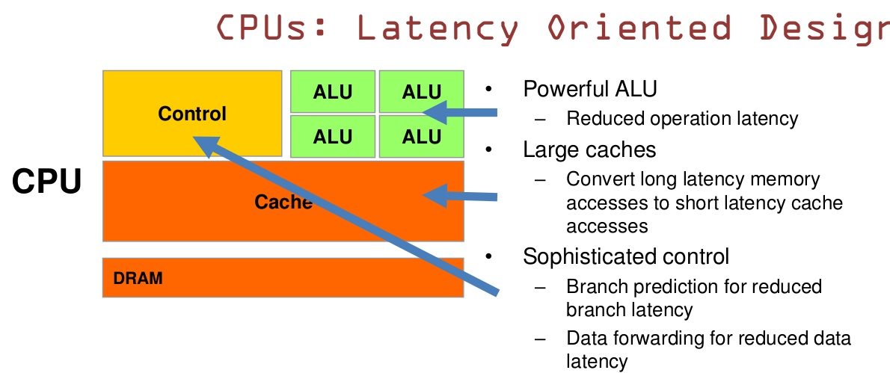
CPU vs GPU
Notes:
CPU有强大的ALU（算术运算单元）,它可以在很少的时钟周期内完成算术计算。时钟周期:计算机中最基本的、最小的时间单位。当今的CPU可以达到64bit 双精度。执行双精度浮点源算的加法和乘法只需要1～3个时钟周期。大的缓存也可以降低延时。复杂的逻辑控制单元。当程序含有多个分支的时候，它通过提供分支预测的能力来降低延时。DRAM（Dynamic Random Access Memory）
CPU执行指令，处理数据，增加内存接口，增加晶体管。
CPU结构图数据通道和控制逻辑
时间的临近性
空间的临近性
CPU内部的并行性：指令并行；数据级并行；线程性并行；
CPU为串行程序优化：pipelines, branch predication, superscalar, OoO; reduce execution time with high clock speeds and high utilization
缓慢的内存带宽（存储器带宽）将会是大问题
并行处理是方向：sandy bridge-E 6-12活动线程

Slide 4
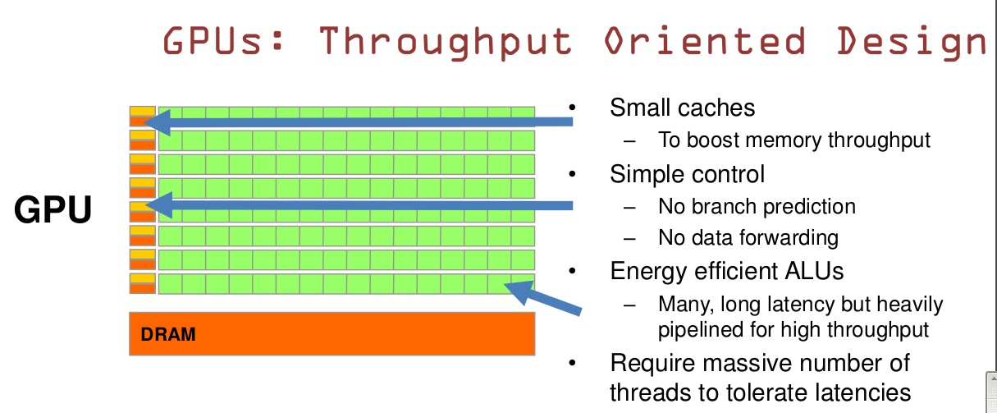
CPU vs GPU
Notes:
GPU是基于大的吞吐量设计。GPU的特点是有很多的ALU和很少的cache。缓存的目的不是保存后面需要访问的数据的，这点和CPU不同，而是为thread提高服务的。计算密集型的程序，易于并行的程序

Slide 5
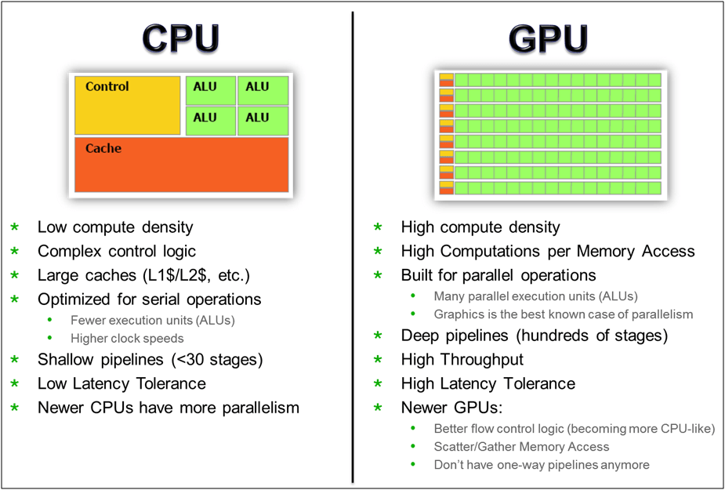
CPU vs GPU

Slide 6
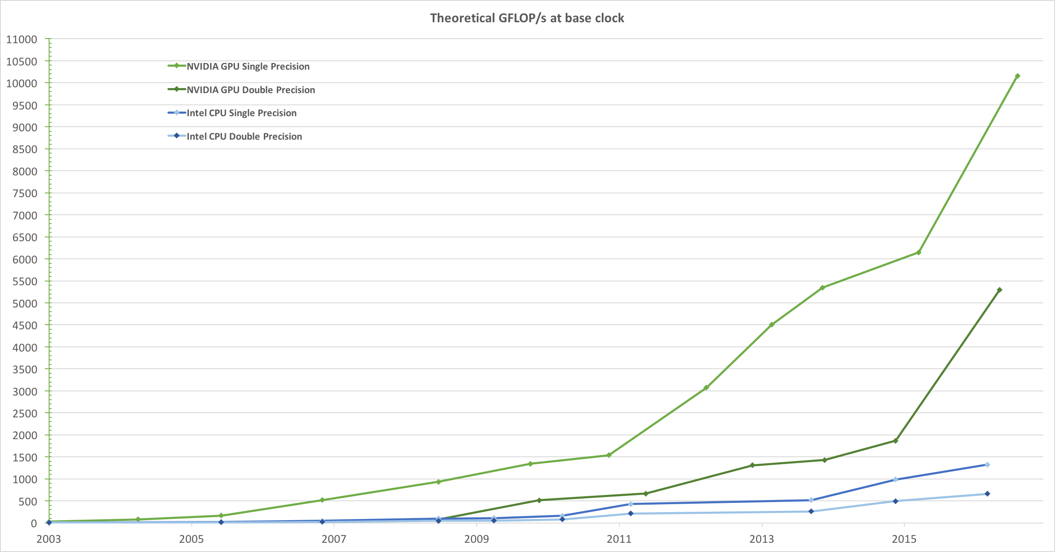
Figure 1. Floating-Point Operations per Second for the CPU and GPU

Slide 7
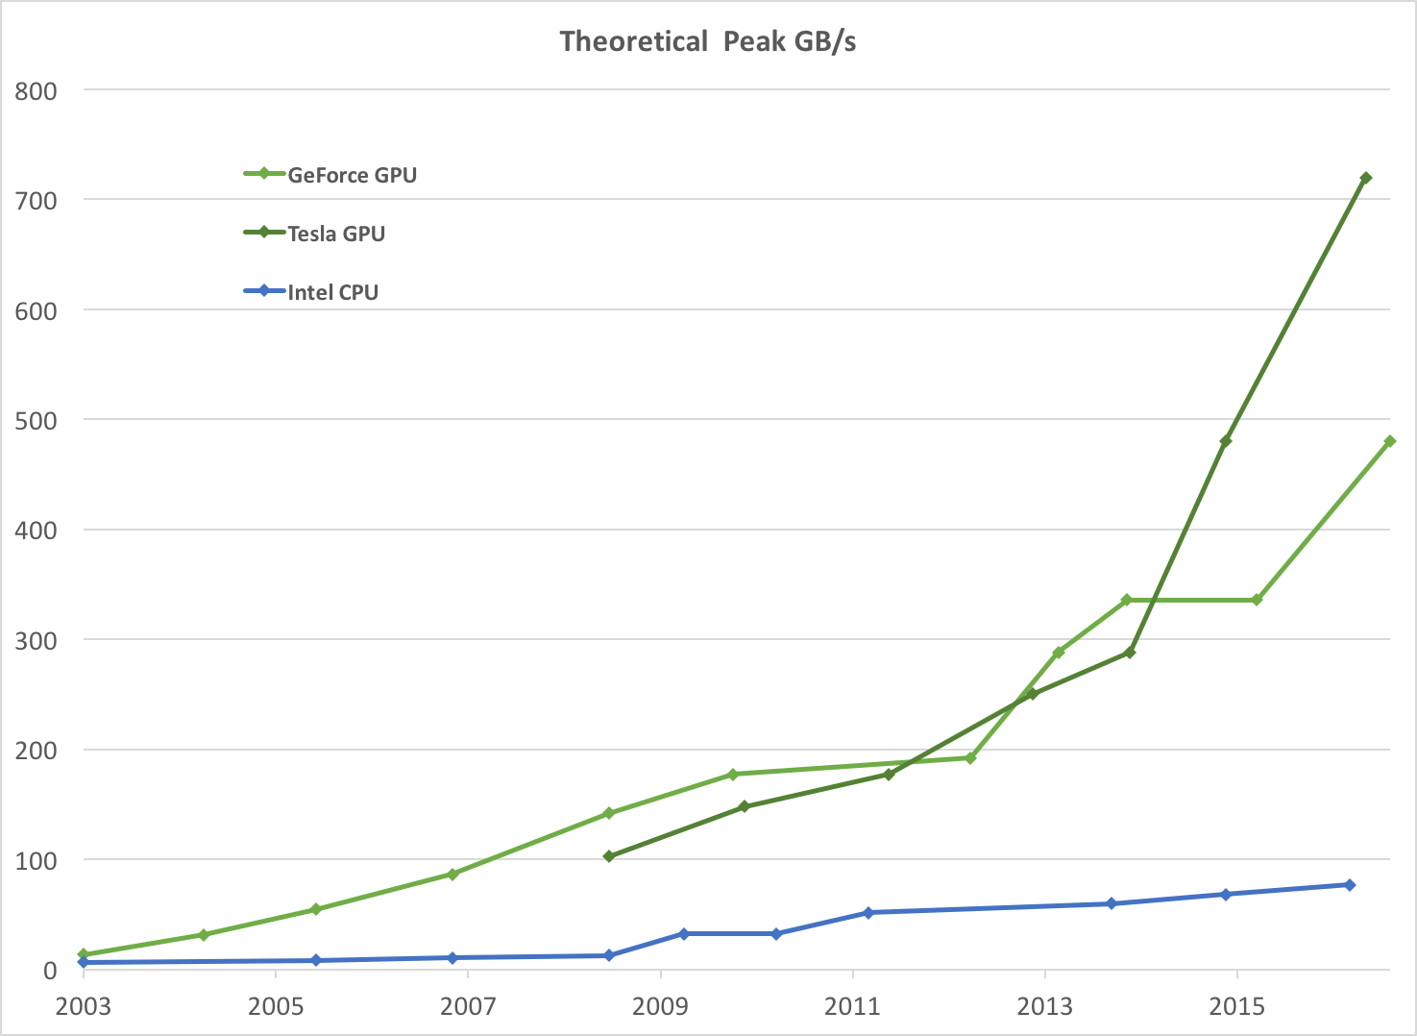
Figure 2. Memory Bandwidth for the CPU and GPU

Slide 8
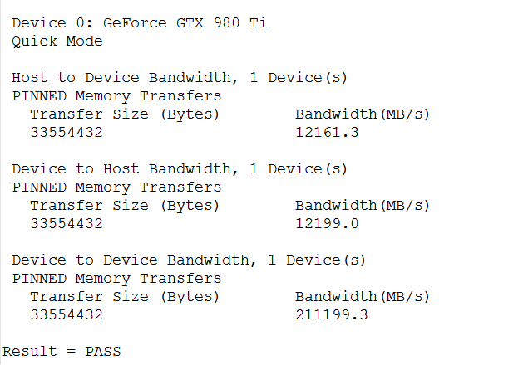
cat /proc/cpuinfo
Intel(R) Xeon(R) CPU E5-2680 v4 @ 2.40GHz
/opt/cuda-samples/NVIDIA_CUDA-7.5_Samples/bin/x86_64/linux/release

Slide 9
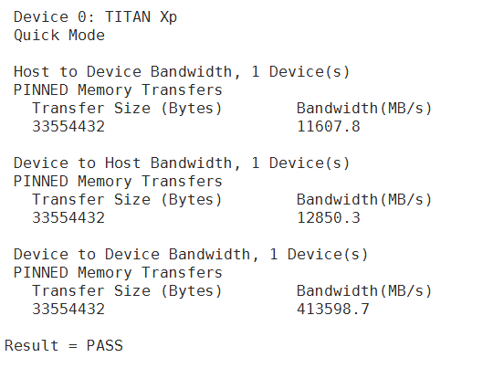
/usr/local/cuda/samples/1_Utilities/bandwidthTest

Slide 10

Play Demonstration

Slide 11
Flynn matrix
The matrix below defines the 4 possible classifications according to Flynn
SISD
Single Instruction, Sigle Data
SIMD
Single Instruction, Multiple Data
MISD
Multiple Instruction, Sigle Data
MIMD
Multiple Instruction, Multiple Data
Notes:
SIMD:同时板多块转
MISD:几个人同时板一张大桌子

Slide 12
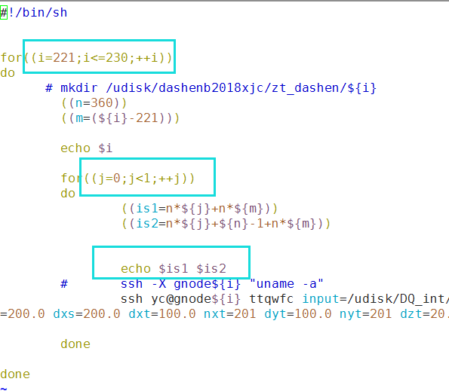
TTCAL

Slide 13
Task（任务）
Parallel Task（并行任务）
Serial Execution（串行执行）
Parallel Execution （并行执行）
Shared Memory（共享存储）
Distributed Memory（分布式存储）
Communications（通信）
Synchronization（同步）
Granularity（粒度）
Observed Speedup（加速比）
Parallel Overhead（并行开销）
Scalability（可扩展性）
Notes:
同步导致性能的下降
粒度:每个人板多少块砖
加速比 1/(1-p) p代表可以并行的部分
可扩展性的极限就是指可并行化的比重

Slide 14
并行编程模型
共享存储模型 Shared Memory Model
线程模型 Threads Model
消息传递模型 Message Passing Model
数据并行模型 Data Parallel Model

Slide 15
CUDA
CUDA integrated CPU+GPU application C program
Serial or modestly parallel C code executes on CPU
Highly parallel SPMD kernel C code executes on GPU
CPU Serial Code
Grid 0
GPU Parallel Kernel
KernelA<<< nBlk, nTid >>>(args);
. . .
CPU Serial Code
Grid 1
GPU Parallel Kernel
KernelB<<< nBlk, nTid >>>(args);
. . .

Slide 16
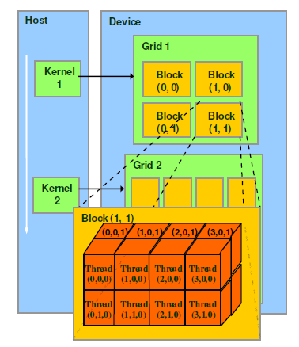
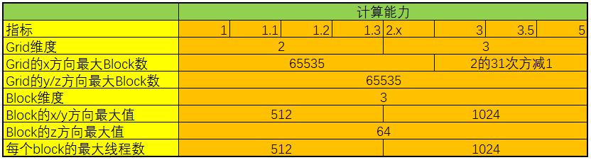
CUDA
thread：一个CUDA的并行程序会被以许多个threads来执行。
block：数个threads会被群组成一个block，同一个block中的threads可以同步，也可以通过shared memory通信。
grid：多个blocks则会再构成grid。
Notes:
/*
另外：Block和Thread都有各自的ID，记作blockIdx（1D，2D），threadIdx（1D，2D，3D）
Block和Thread还有Dim，即blockDim与threadDim. 他们都有三个分量x，y，z
线程同步：void __syncthreads(); 可以同步一个Block内的所有线程
总结来说，每个 thread 都有自己的一份 register 和 local memory 的空间。
一组thread构成一个 block，这些 thread 则共享有一份shared memory。
此外，所有的 thread(包括不同 block 的 thread)都共享一份
global memory、constant memory、和 texture memory。
不同的 grid 则有各自的 global memory、constant memory 和 texture memory。
*/

Slide 17
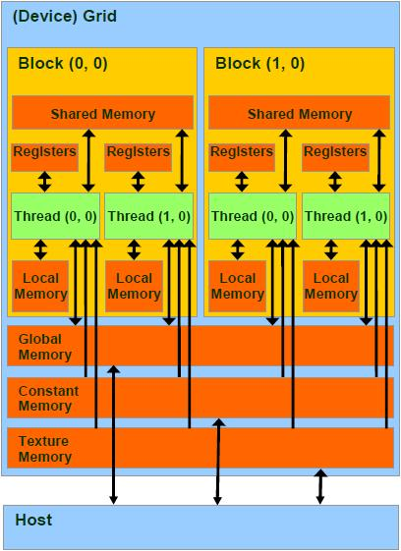
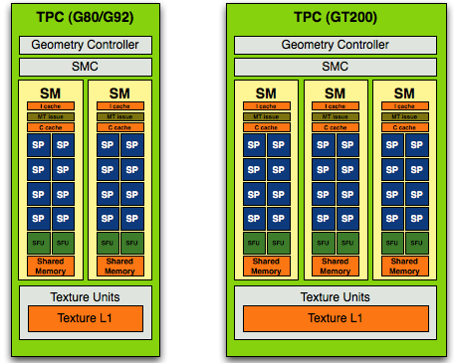
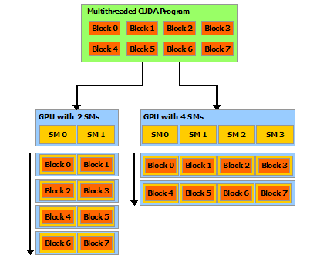
Hardware & software

Slide 18
CUDA Devices and Threads
A compute device
Is a coprocessor to the CPU or host
Has its own DRAM (device memory)
Runs many threads in parallel
Is typically a GPU but can also be another type of parallel processing device
Data-parallel portions of an application are expressed as device kernels which run on many threads
Differences between GPU and CPU threads
GPU threads are extremely lightweight
Very little creation overhead
GPU needs 1000s of threads for full efficiency
Multi-core CPU needs only a few

Slide 19
CUDA Extends C
__device__ float filter[N];
__global__ void convolve (float *image) {
__shared__ float region[M];
...
region[threadIdx] = image[i];
__syncthreads()
...
image[j] = result;
}
// Allocate GPU memory
void *myimage = cudaMalloc(bytes)
// 100 blocks, 10 threads per block
convolve<<<100, 10>>> (myimage);
Declspecs
global, device, shared, local, constant
Keywords
threadIdx, blockIdx
Intrinsics
__syncthreads
Runtime API
Memory, symbol, execution management
Function launch
Notes:
Instrinsics固有的

Slide 20
Arrays of Parallel Threads
A CUDA kernel is executed by an array of threads
All threads run the same code (SIMD)
Each thread has an ID that it uses to compute memory addresses and make control decisions
threadID
0 | 1 | 2 | 3 | 4 | 5 | 6 | 7
…
float x = input[threadID];
float y = func(x);
output[threadID] = y;
…

Slide 21
Thread Blocks: Scalable Cooperation
Divide monolithic thread array into multiple blocks
Threads within a block cooperate via shared memory, atomic operations and barrier synchronization
Threads in different blocks cannot cooperate
Thread Block 0
Thread Block 1
Thread Block N - 1
threadID
0 | 1 | 2 | 3 | 4 | 5 | 6 | 7
0 | 1 | 2 | 3 | 4 | 5 | 6 | 7
0 | 1 | 2 | 3 | 4 | 5 | 6 | 7
…
float x = input[threadID];
float y = func(x);
output[threadID] = y;
…
…
float x = input[threadID];
float y = func(x);
output[threadID] = y;
…
…
float x = input[threadID];
float y = func(x);
output[threadID] = y;
…
…

Slide 22
Block IDs and Thread IDs
Each thread uses IDs to decide what data to work on
Block ID: 1D or 2D
Thread ID: 1D, 2D, or 3D
Simplifies memory addressing when processing multidimensional data
Image processing
Solving PDEs on volumes
…
Device
Grid 1
Block
(0, 0)
Block
(1, 0)
Block
(2, 0)
Block
(0, 1)
Block
(1, 1)
Block
(2, 1)
Block (1, 1)
Thread
(0, 0)
Thread
(1, 0)
Thread
(2, 0)
Thread
(3, 0)
Thread
(4, 0)
Thread
(0, 1)
Thread
(1, 1)
Thread
(2, 1)
Thread
(3, 1)
Thread
(4, 1)
Thread
(0, 2)
Thread
(1, 2)
Thread
(2, 2)
Thread
(3, 2)
Thread
(4, 2)

Slide 23
CUDA Memory Model Overview
Global memory
Main means of communicating R/W Data between host and device
Contents visible to all threads
Long latency access
We will focus on global memory for now
Grid
Block (0, 0)
Block (1, 0)
Shared Memory
Shared Memory
Registers
Registers
Registers
Registers
Thread (0, 0)
Thread (1, 0)
Thread (0, 0)
Thread (1, 0)
Host
Global Memory

Slide 24
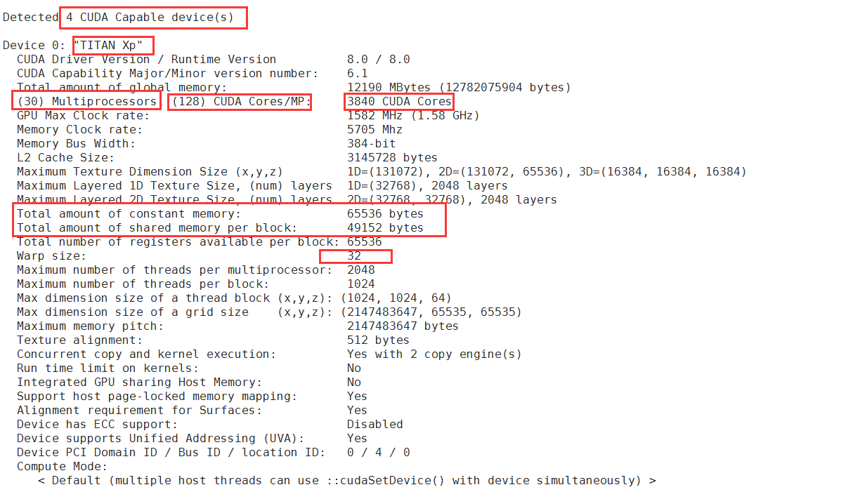
/usr/local/cuda/samples/1_Utilities/deviceQuery

Slide 25
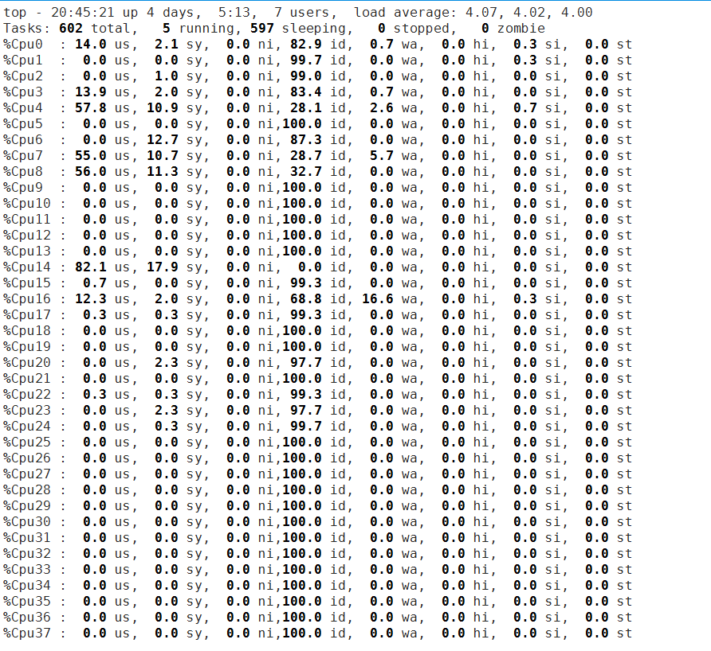

Slide 26
/**************************************************************/
// ！！！！！！！！！！！！！！注意！！！！！！！！！！！！！！！！
/**************************************************************/
// grid划分成a维，block划分成b维，
// 等价于
// blocks是a维的，Threads是b维的。
// 这里，本人用的是第一中说法。
/**************************************************************/
// 情况1：grid划分成1维，block划分为1维。
__device__ int getGlobalIdx_1D_1D() {
int threadId = blockIdx.x *blockDim.x + threadIdx.x;
return threadId;
}
// 情况2：grid划分成1维，block划分为2维。
__device__ int getGlobalIdx_1D_2D() {
int threadId = blockIdx.x * blockDim.x * blockDim.y
+ threadIdx.y * blockDim.x + threadIdx.x;
return threadId;
}
// 情况3：grid划分成1维，block划分为3维。
__device__ int getGlobalIdx_1D_3D() {
int threadId = blockIdx.x * blockDim.x * blockDim.y * blockDim.z
+ threadIdx.z * blockDim.y * blockDim.x
+ threadIdx.y * blockDim.x + threadIdx.x;
return threadId;
}
// 情况4：grid划分成2维，block划分为1维。
__device__ int getGlobalIdx_2D_1D() {
int blockId = blockIdx.y * gridDim.x + blockIdx.x;
int threadId = blockId * blockDim.x + threadIdx.x;
return threadId;
}
// 情况5：grid划分成2维，block划分为2维。
__device__ int getGlobalIdx_2D_2D() {
int blockId = blockIdx.x + blockIdx.y * gridDim.x;
int threadId = blockId * (blockDim.x * blockDim.y)
+ (threadIdx.y * blockDim.x) + threadIdx.x;
return threadId;
}
// 情况6：grid划分成2维，block划分为3维。
__device__ int getGlobalIdx_2D_3D() {
int blockId = blockIdx.x + blockIdx.y * gridDim.x;
int threadId = blockId * (blockDim.x * blockDim.y * blockDim.z)
+ (threadIdx.z * (blockDim.x * blockDim.y))
+ (threadIdx.y * blockDim.x) + threadIdx.x;
return threadId;
}
// 情况7：grid划分成3维，block划分为1维。
__device__ int getGlobalIdx_3D_1D() {
int blockId = blockIdx.x + blockIdx.y * gridDim.x
+ gridDim.x * gridDim.y * blockIdx.z;
int threadId = blockId * blockDim.x + threadIdx.x;
return threadId;
}
// 情况8：grid划分成3维，block划分为2维。
__device__ int getGlobalIdx_3D_2D() {
int blockId = blockIdx.x + blockIdx.y * gridDim.x
+ gridDim.x * gridDim.y * blockIdx.z;
int threadId = blockId * (blockDim.x * blockDim.y)
+ (threadIdx.y * blockDim.x) + threadIdx.x;
return threadId;
}
// 情况9：grid划分成3维，block划分为3维。
__device__ int getGlobalIdx_3D_3D() {
int blockId = blockIdx.x + blockIdx.y * gridDim.x
+ gridDim.x * gridDim.y * blockIdx.z;
int threadId = blockId * (blockDim.x * blockDim.y * blockDim.z)
+ (threadIdx.z * (blockDim.x * blockDim.y))
+ (threadIdx.y * blockDim.x) + threadIdx.x;
return threadId;
}

